Slide 1

Stanley Black & Decker – Emory MSBA
Capstone Final Project Readout
Using digital customer feedback for insights of categories, products and features.
April 20, 2020

Slide 2
Overview
1
Business Understanding
4
Insights
2
Our Approach
5
Dashboard
3
Modelling
6
Appendix

Slide 3
Business Understanding

Slide 4
When We Select Products online, there are all kinds of comments on products:
The batteries are budget friendly and perform as well as my dewalt batteries.
The safety trigger is conveniently atop the trigger so that when you go to use the trimmer, just move your hand over the safety switch and apply the throttle with your fingers.
Great to have extended use time but the heavier weight gets to be a drawback after long use.
How to use these comments for business insights?

Slide 5








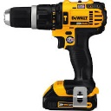
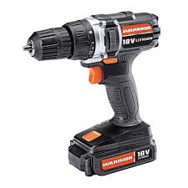
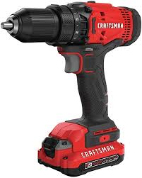
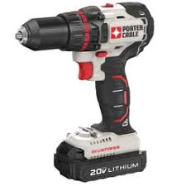
Business Understanding
Different retailer
SBD wants to know all the customer review intelligence on competitor’s products and SBD products across different retailers, for product developers to understand pain points and sentiments on features, on both category levels and product levels, in order to make decisions on new product introduction or product improvement.
Different brands
Different categories
Power Drills, Tape Measure, Reciprocating Saws, Impact Wrenches……
Different products
Different features
Blade, Battery, Charger, Compressor, Handle, Sweeper, Wheels……

Slide 6
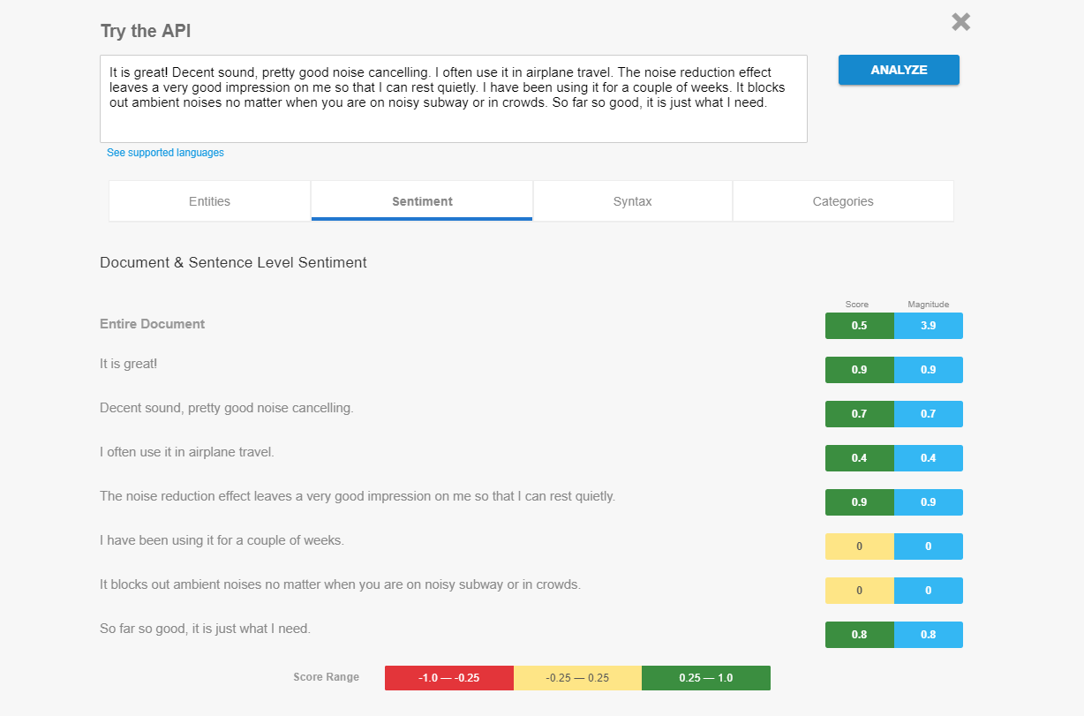
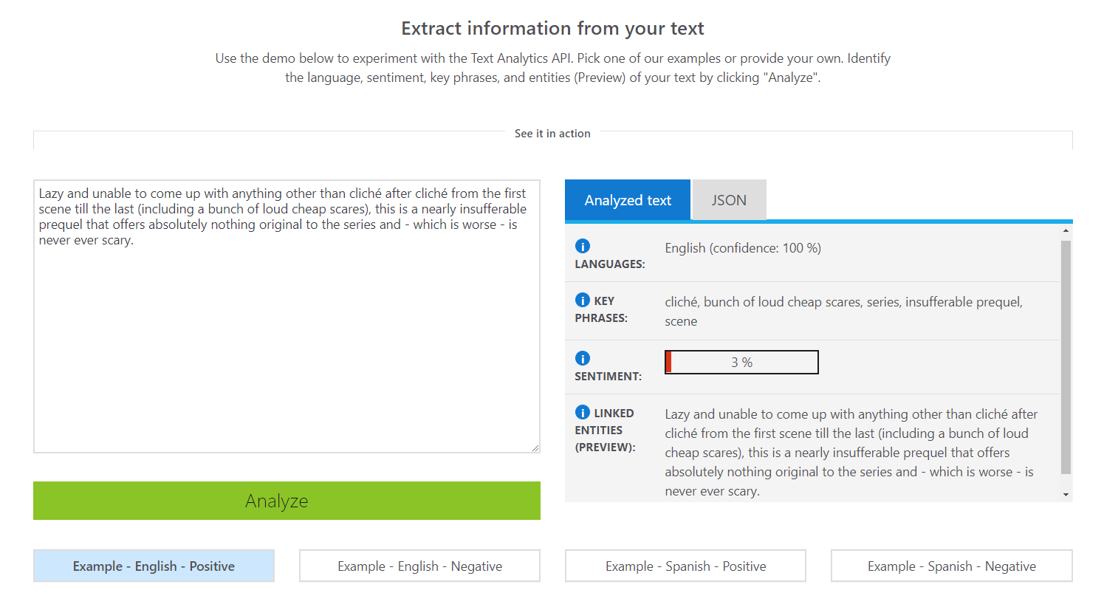
Sentiment Analysis: It’s rather common to use off-the-shelf tools and APIs
Various customer experience software (e.g. InMoment, Clarabridge) collect feedback from numerous sources, alert on mentions in real-time, analyze text, and visualize results. Text analysis platforms (e.g. DiscoverText, IBM Watson Natural Language Understanding, Google Cloud Natural Language, or Microsoft Text Analytics API) have sentiment analysis in their feature set.
Sentiment analysis results by Google Cloud Natural Language API
Sentiment analysis results by Microsoft Text Analytics API
However, commercial software may be less accurate when analyzing texts from specific domains and industries. For example, there can be negative words aren’t negative if used in particular contexts. For these cases, our team come to cooperate and develop a solution that fits our industry.

Slide 7
Our Approach

Slide 8
Data Preparation Flow
Combined datasets from web scraping, removed duplications, filtered out unreasonable information
Extracted retailer and competitor brand information
Synthesized categories for the same model from different retailers
Step 1
Step 2
Step 3
Used SBD’s competitor list to focus on main competitors in the tool category
Step 4
102648 comments ​
396 categories​
7747 products​
48 brands
*SBD – 10 , competitors - 38
Joined category-level reviews and conduct text-processing on Top reviewed categories
Step 5
Aggregated reviews to remove categories with less than 100 reviews
Step 6

Slide 9
Data Preparation contd.
Extract retailer
https://www.homedepot.com/p/Milwaukee-M12-12-Volt-Lithium-Ion-Cordless-3-8-in-Impact-Wrench-Tool-Only-2463-20/204390536
Example:
Model 0882-20
Home depot: Specialty Power Tools (95)
Synthesized categories
Walmart: Stick Vacuums (5)
SBD brands: STANLEY, Stanley FatMax, DEWALT, Black & Decker,
Craftsman, IRWIN, Porter Cable, LENOX, BOSTITCH, PROTO
The other brands are from competitors
Recognize competitors
Utilize regulation expression to remove special symbols
Remove stop words, Stemming and Lemmatization
Text processing

Slide 10
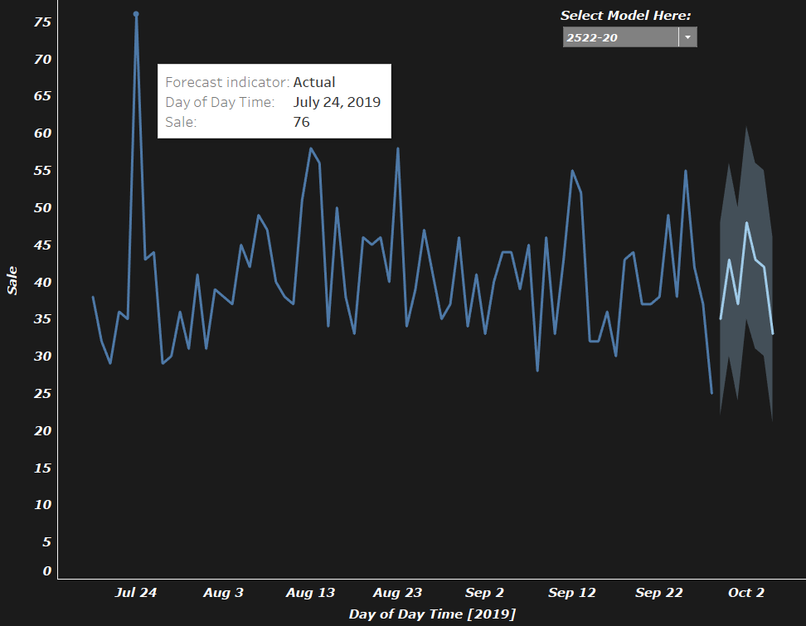
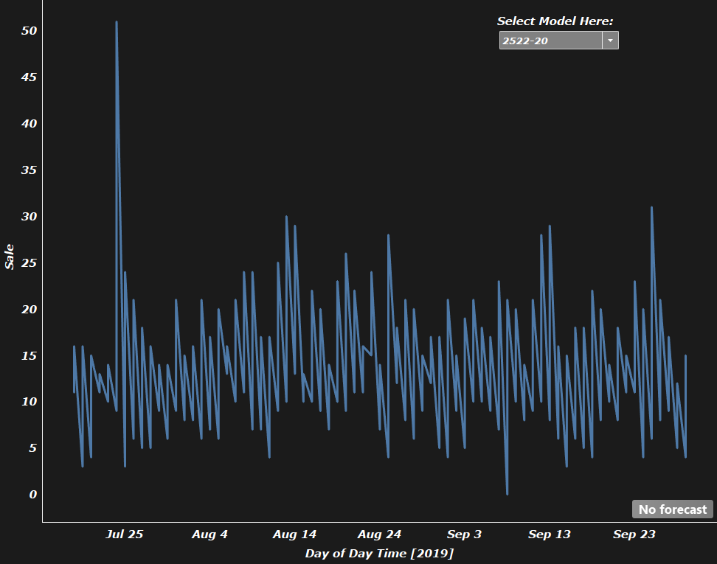
Data Preparation - Sales Data
Aggregate by product on four time periods on daily level
Calculate daily sale and daily revenue (price*sale_unit)
Visualize in line chart and apply time series forecasting on sale
Data from July to September in 2019, not suitable for long-term prediction
Daily sale and forecasting & four time periods sale of product 2522-20 From July to September 2019

Slide 11
Modeling

Slide 12
Modeling Process
What do we mean by features?
Features of “Power Tool Combo Kits”
Battery | Price | Shape
Power | Drill | Quality
charger | Service | Cutting
Metal | Couple | Value
Blade | Switch | Weight
Capacity | Balance | Chain
Pressure | Impact | Design
Motor | Trigger | Speed
Cord | Energy | Button
Driver | Screw | Lithium
Feature Extraction
Compute Sentiment Scores on Feature Level
Category :
Power Tool Combo Kits
Reviews: 88,887

Slide 13
Feature Extraction
Models
LDA
LSA
PLSA
Evaluation
Accuracy (manually Look at how many features make sense)
Category Level:
More Reviews => Better Features
Features that are not applicable to the products are anyway disregarded because we are using the matching technique
All the features extracted are applicable to all the products in that specific category

Slide 14
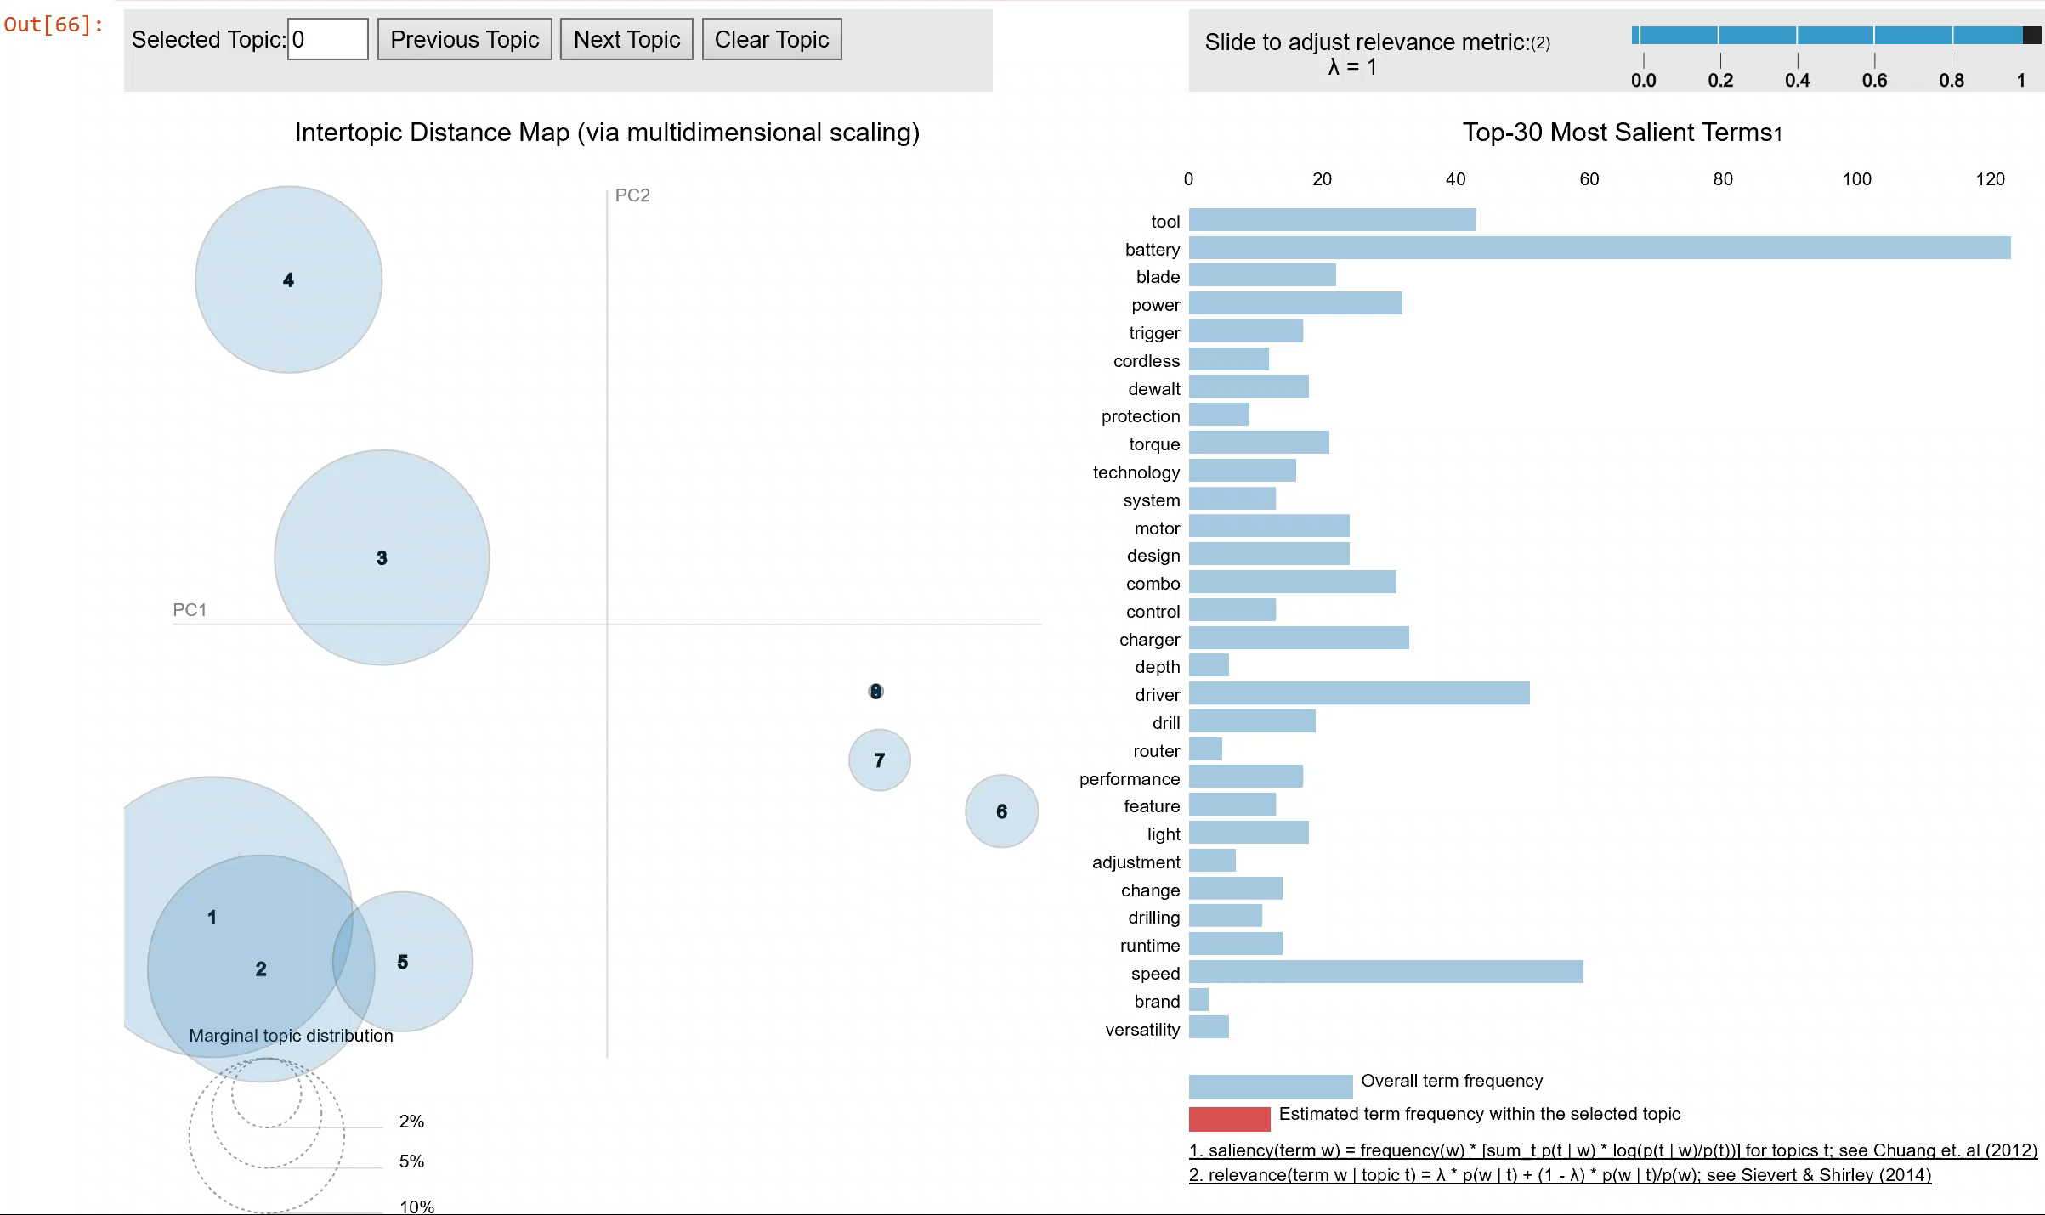
Manually select the words from each topic (or) select top 5 words from each topic
How we extract features?

Slide 15
LDA​ | LSA​ | PLSA​ | BOW using LDA
Battery​ | Battery | Weight​ | Blade
Power​ | Power​ | Light​ | Trigger
Charger | Charger​ | Balance​ | Power
Light​ | Area | Quality | Switch
Handle​ | Light | Year | Handle
Capacity​ | Blade | Power​ | Shape
Indicator | Minute​ | Blade | Rubber
Torque | Model​ | Yard​ | Handle
Lithium​ | Product​ | Price​ | Tool
Couple | Handle | Store​ | Motor
Speed​ | Couple | Button | Torque
Quality | Weight​ | Start​er | Light
Cutting | Pressure | Speed​ | Battery
Weight | Switch | Repair | Charger
Impact | Capacity​ | Plenty​ | Impact
100% | 80% | 73% | 100%
Model Outputs Comparison
Category : Power Tool Combo Kits
Reviews : 88,887
LDA : Picking only top 2 words from each topic
LSA : Picking top ranked words
PLSA : Picking top ranked words
Key words extracted with LDA model using only product descriptions data and not reviews
Final Best Model:
Method 1:
Give these words extra priority when building LDA model with review data
Method 2:
Take an intersection between these words and outputs from LDA model with review data
Method 3:
Use them as features as directly

Slide 16
Model Comparison Summary
Probabilistic Latent Semantic Analysis
(PLSA)
Latent Semantic Analysis
(LSA)
Latent Dirichlet Allocation
(LDA)
TRAINING SPEED
TRAINING SPEED
TRAINING SPEED
x
1.5x
2x
ACCURACY
ACCURACY
ACCURACY
70%
80%
90%
INTERPRETABILITY OF RESULTS
INTERPRETABILITY OF RESULTS
INTERPRETABILITY OF RESULTS
Very Difficult
Difficult
Very Easy

Slide 17
Computation of Sentiment Scores
Category | Model | Review
Power Tool Combo Kits | 308056104 | Surprising power for this little tool. Batteries charged quickly and held their charge. I like the button to check the charge. Overall, It is great
27 Features
Power , Battery​, Button, Charger, Light​,Handle ,​Capacity ,Torque, Indicator, Lithium​, Couple, Speed,​ Quality, Weight, Impact, Handle, Screw, Drill, Cord, Starter, Socket, Attachment, Storage, Extension, Adapter, Wire
Category | Model | Review | Sentence | Features | Score
Power Tool Combo Kits | 308056104 | Surprising power for this little tool. Batteries charged quickly and held their charge. I like the button to check the charge | Surprising power for this little tool. | Power | 0.63
Power Tool Combo Kits | 308056104 | Surprising power for this little tool. Batteries charged quickly and held their charge. I like the button to check the charge | Batteries charged quickly and held their charge | Battery | 0.3
Power Tool Batteries | 308056104 | Surprising power for this little tool. Batteries charged quickly and held their charge. I like the button to check the charge | I like the button to check the charge | Button | 0.28

Slide 18
Insights

Slide 19
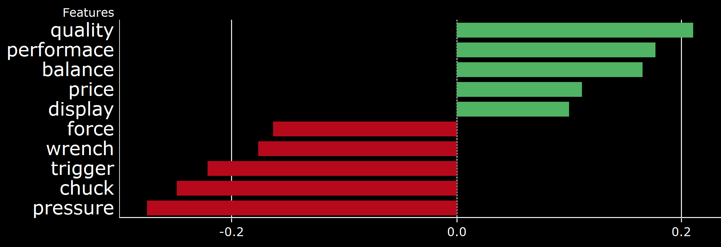
Insights
For each product category, we identified the most positive and most negative features.
The 5 Most Positive and Most Negative Features for the Power Tool Combo Kits Category
5 Most positively-perceived and negatively-perceived features are analyzed for each category.

Slide 20
Insights
The most relevant reviews related with a particular feature are highlighted for more contexts.
The Most Relevant Positive Reviews for “Balance” in the Power Tool Combo Kits Category
I\u2019m mostly on the 20v platform, but I tried this 12v kit and it is now my go-to drill and impact that I reach for on list jobs. Both pieces are lightweight, well balanced, have good battery life (kudos for the battery charge gauge) and deliver decent power. I also really like the speed settings on the impact driver. If you\u2019re looking for a good set for basic work, look no further
Impact driver- weight is nicely balanced making it easy to hold. Comfortable rubber grip. Bright auto on/off work area light. Easy to change speeds and bits. Plenty of torque, does the job efficiently. Light on the back that shows battery life. Battery is easy to install and remove. Love this driver
This drill is well balanced and fits my hand much better than my old one. I found it much easier to forward and reverse the drill as I was working without having to move my whole hand. I could just move my knuckles to press for each direction. Love it And it was on sale too. Win - win.
This is a great drill/driver combo. The impact driver is probably my most used tools out of my arsenal of the 24 volt tools I have. The 2ah battery that's included gives both tools a very good balance tool balance and good run time. As a mechanic I tend to grab this for most bolts and the power of the driver can break most bolts free.

Slide 21
Insights
The most relevant reviews related with a particular feature are highlighted for more contexts.
The Most Relevant Negative Reviews for “Chuck” in the Power Tool Combo Kits Category
Everything I've tried functions well, however the hammer drill gets too hot and the chuck wobble is too much. Milwaukee work on your hammer drill
Over good but chuck is weak.
The tool performed very good when brand new. I've had it about 3-1/2 years (out of warranty). Within the warranty period, both batteries died but Ryobi sent two replacements which was good product support. But the battery life was surprisingly short. Now, the chuck developed a wobble so I can't drill a straight hole or drive screws cleanly. I will probably replace it with another Ryobi because I have the batteries and charger. Hopefully, they have made improvements for a longer life.
This drill could not get cheaper. the charger is the smallest from their catalogue and is not even sold separately. There is no amp hours on the battery but I figured out they were 1.3. And the drill chuck has bad wobble.

Slide 22
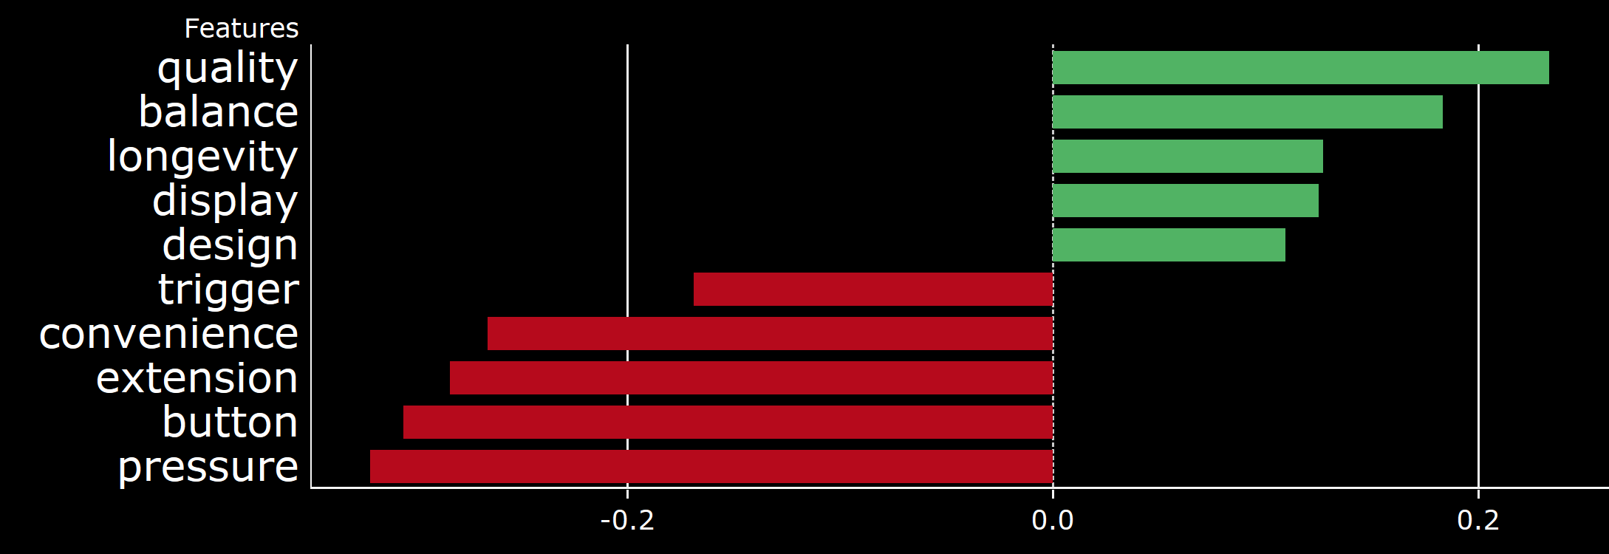

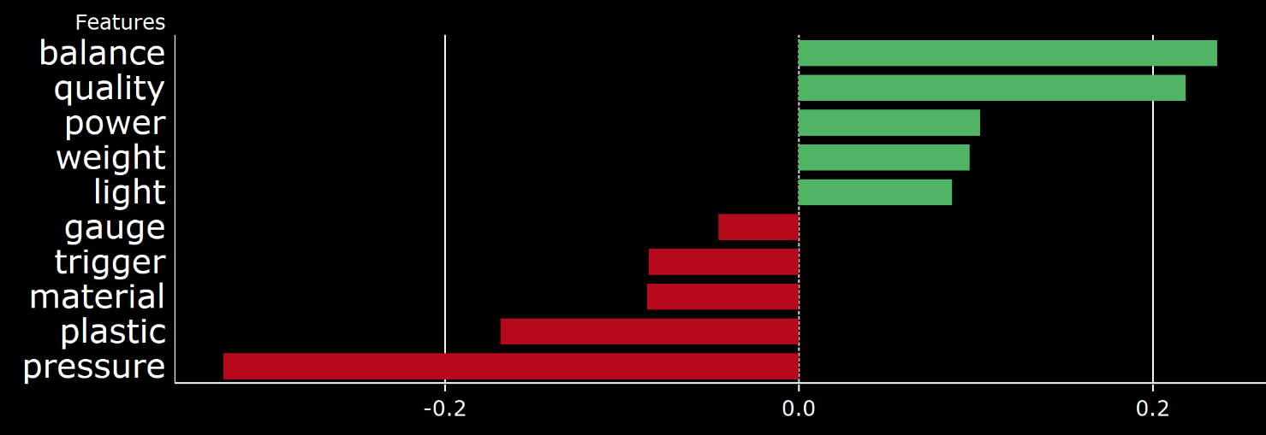

Insights
Features for the competing brands in the Power Tool Combo Kits Category
Electronic, clear, lighted display is a top feature for the Milwaukee brand that Dewalt can improve on
For Dewalt, there are some negative sentiments around the material/plastic

Slide 23
Next Steps

Slide 24
Next Steps
Data Collection
Each category should have at least 1,000 reviews to generate meaningful insights.
Domain Knowledge
We need to integrate domain knowledge into the feature words selection process.

Slide 25
Dashboard Demo

Slide 26

Home Page

Slide 27
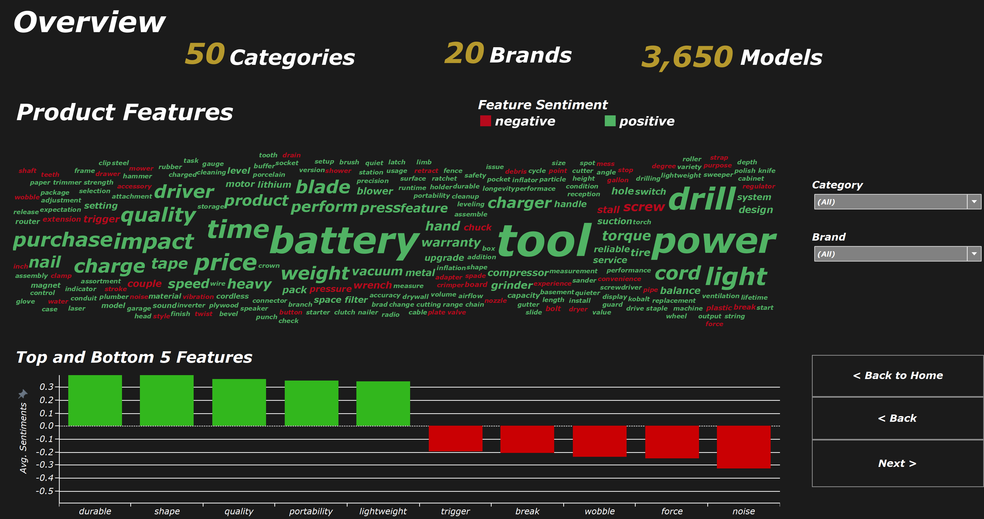
Category Level Analysis

Slide 28
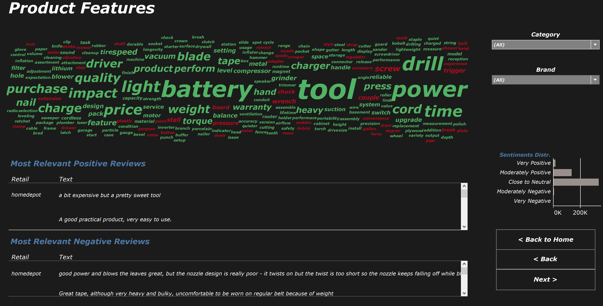
Review Highlights

Slide 29
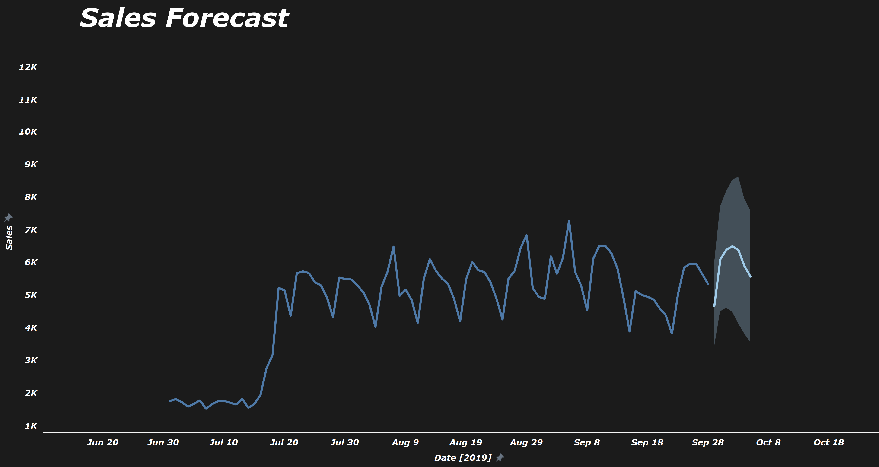
Sales and Forecasts
Predicted Sales

Slide 30
Thank you!

Slide 31
Appendix

Slide 32
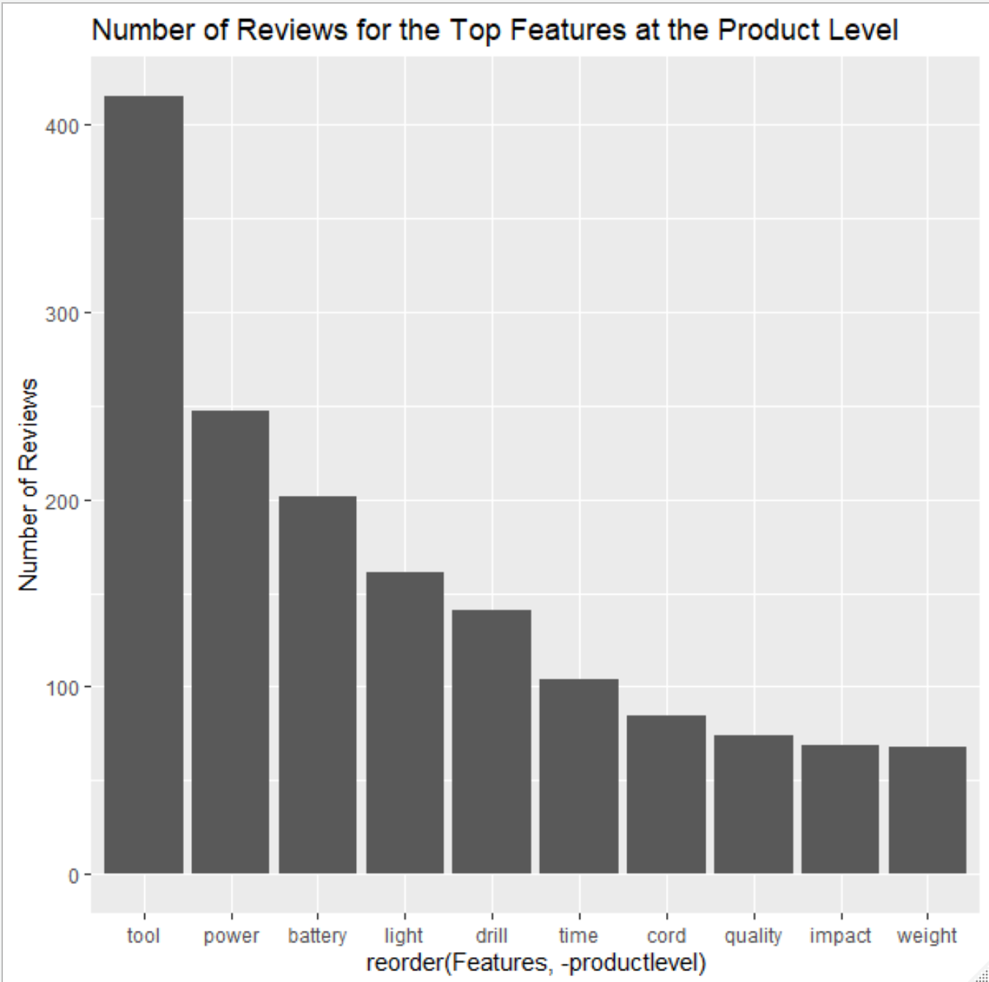
Determine the Level of Analysis
To analyze features, we first have to identify the right level of analysis
We sampled the products with the most reviews related to features, to see how their number of related reviews are distributed
For example, one of the products with the most reviews - product “2498-24-48-11-2440 MILWAUKEE” in the “Power Tool Combo Kits” category, the top 10 features with highest number of reviews are shown here

Slide 33
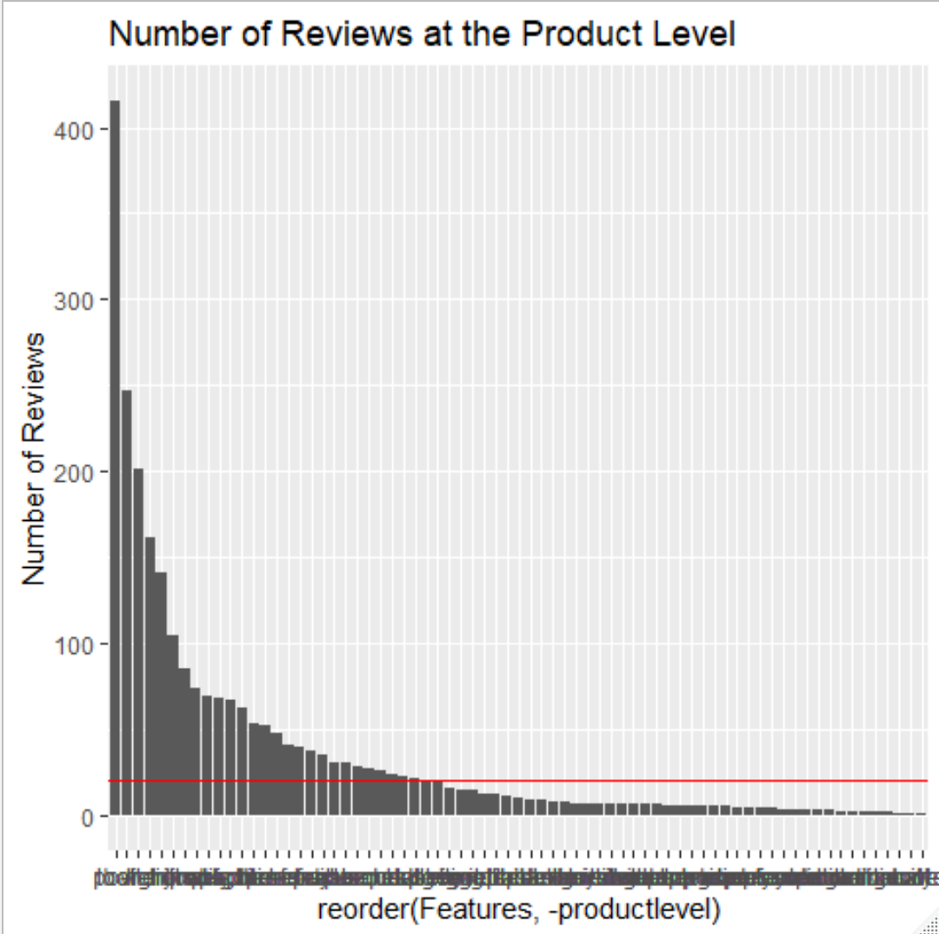
Determine the Level of Analysis
However, as we look at the distribution of all the 71 features in the data set, less than half of those features have a review number of 20, as shown by the red line.
Almost all products follow this distribution, therefore it may not make sense to look into the product level, as we don’t have enough records per feature for each product.

Slide 34
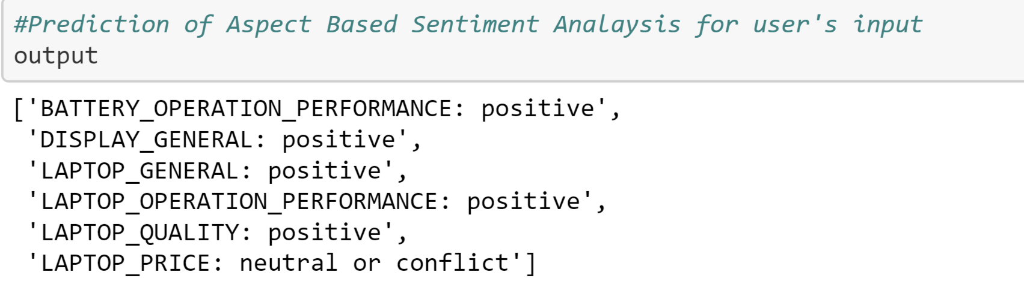
Why not ABSA (Aspect Based Sentiment Analysis)?
Extremely Complex Code.
Train Topics Manually then your model learns ,and will predict on the new reviews what features each of those new reviews has
Output

Slide 35
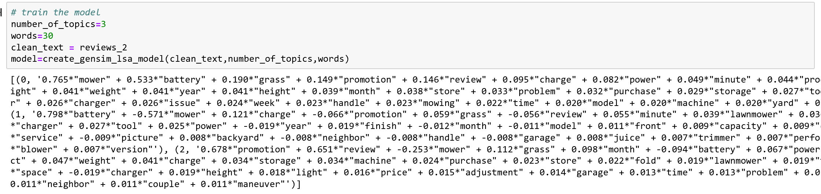
T
Main Positive Aspect
Quick and efficient to use
Shortcomings
Need for really large set of documents and vocabulary to get accurate results. Atleast 5000 reviews to get features
- Poor Model Interpretability
Poor Results
Topic Results
Latent Semantic Analysis
Source: “Topic Modeling with LSA, PLSA, LDA & lda2Vec”, Joyce Xu, Medium.com

Slide 36
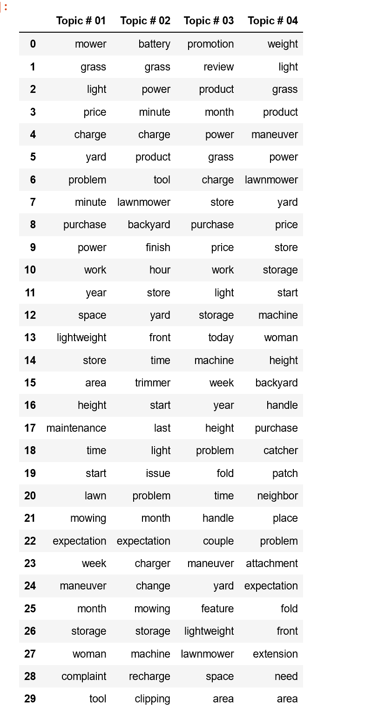
Core Idea
Main Positive Aspect
More flexible model which adds a probabilistic treatment of topics and
words on top of LSA
Shortcomings
Needs a lot of Reviews
Because we have no parameters to model P(D), we don’t know how to
assign probabilities to new documents
- Which Topic is more prevalent?
Probabilistic Latent Semantic Analysis
……
Source: “Topic Modeling with LSA, PLSA, LDA & lda2Vec”, Joyce Xu, Medium.com

Slide 37
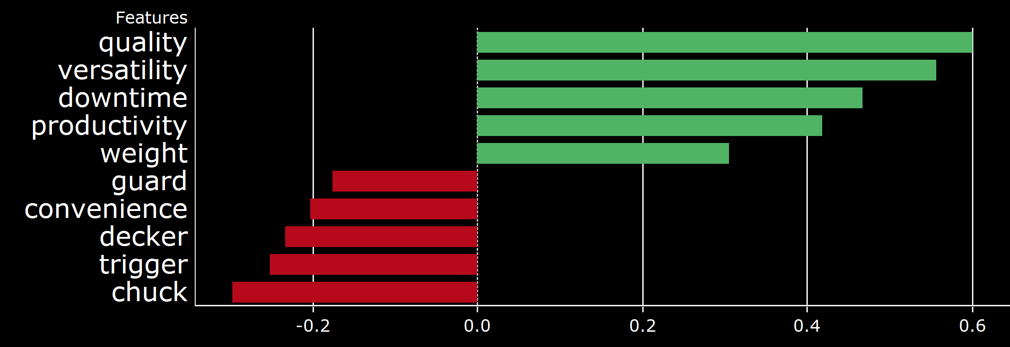
Insights with Product Overview Bag of Words
Using the Bag of Words from product overview from websites, the features are still prone to mistakes.
The 5 Most Positive and Most Negative Features for the Power Tool Combo Kits Category

Slide 38
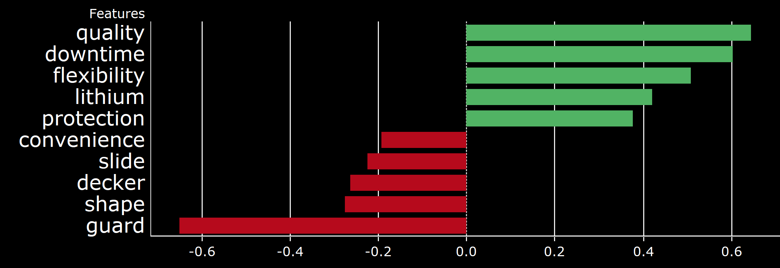
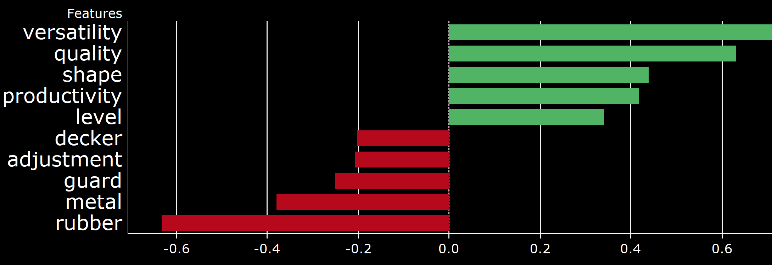
Insights with Product Overview Bag of Words
Features for the competing brands in the Power Tool Combo Kits Category

